Slide 2
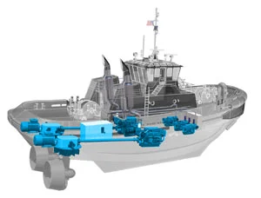
Hybrid Tugboat Feasibility Study
Team 12 Presentation
Mark Livshin mlivshin@umich.edu
Sagar Singhal sagsngl@umich.edu
Stephen Olson olsonsao@umich.edu
Cheng-Chun Chien jimchien@umich.edu
*Citations https://www.professionalmariner.com/industry-closely-watching-hybrid-tug-performance/

Slide 3
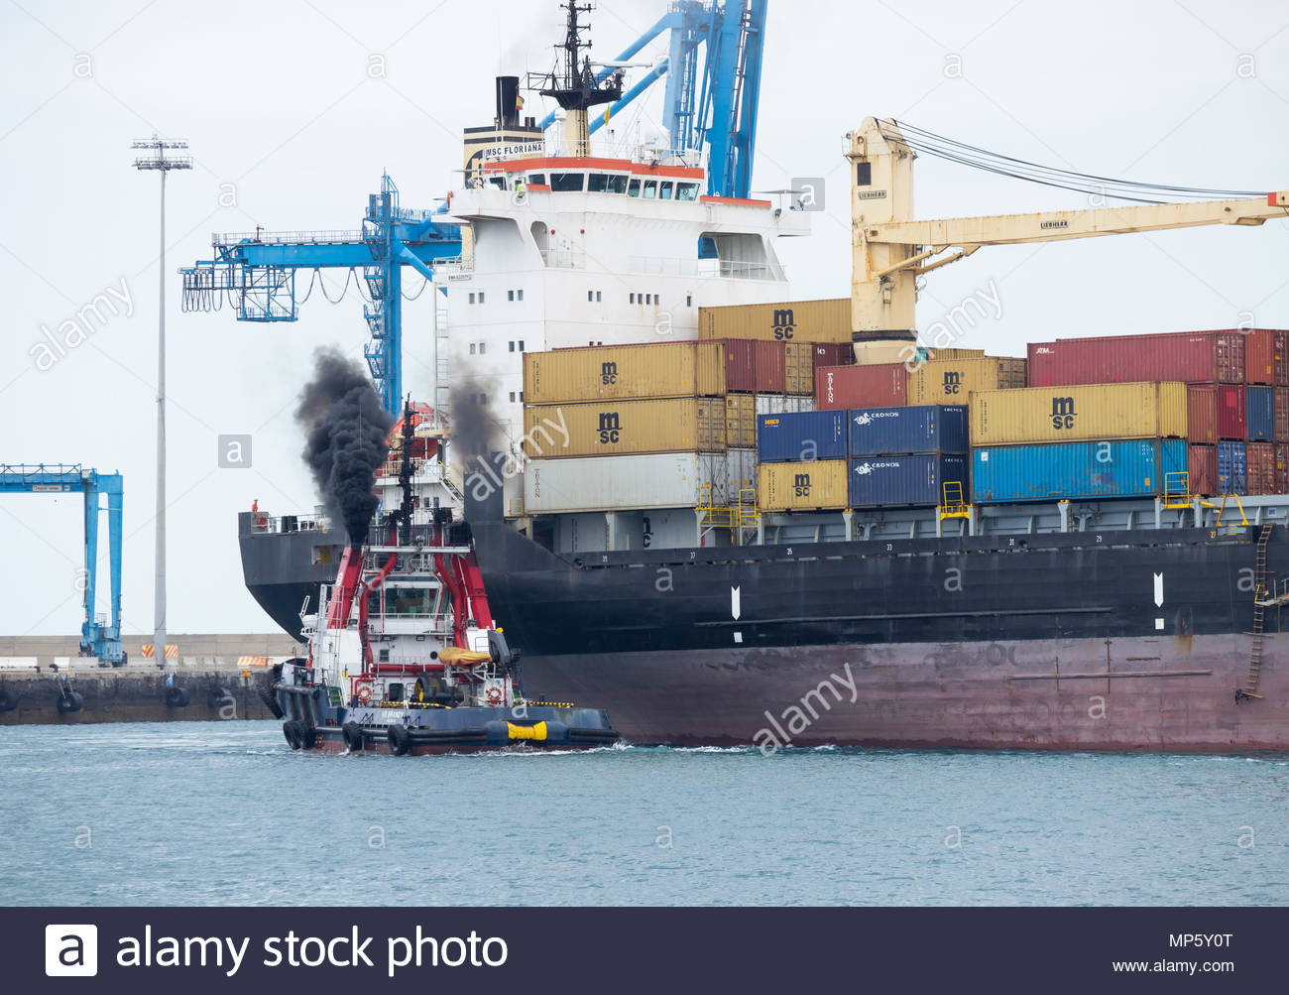
Project Scope and initiative
Problem:
Maritime industry produces 5% of all greenhouse emissions
Tightening emissions regulations worldwide
Need:
A pathway towards the paris agreement of 0 emissions by 2050 must pursued
Hybrid TUGS provide an step forward in the path towards reduced emissions
*https://www.alamy.com/tug-boat-belching-out-black-smoke-as-it-guides-msc-floriana-container-ship-into-port-in-las-palmas-on-gran-canaria-canary-islands-spain-image185757084.html
https://ec.europa.eu/clima/policies/strategies/2050_en
Notes:
Andy/Stephen

Slide 4
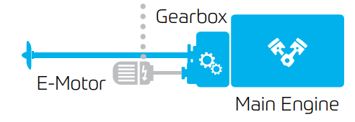
Project Approach
Approach
Evaluate benefits of parallel hybrid approach with and without energy storage and shore charging
Benefit:
Industry pathway to hybridization of Maritime vessels
Solution can be added to existing power plants
Competition:
Model Solutions proposed by ABB and MAN (yet to be implemented)
https://new.abb.com/marine/systems-and-solutions/electric-solutions https://www.man-es.com/marine/solutions/hybrid-marine-propulsion-systems
https://www.zf.com/products/media/industrial/marine/brochures_1/ZF_Product_Overview_2018.pdf
Notes:
Sagar
Series electric currently exist for large scale vessels but haven’t been scaled down Companies market their solutions for bigger vehicles
But tugs and other smaller vessels owned by smaller companies and leased out as needed
Steep cost vs benefit curve and high risk in taking the first step -Hybrid solutions appear costly (resistance to accept)

Slide 5
Deliverables
Construct typical daily load profile
Modeling Simulink - Current / Baseline
Modeling Simulink - potential hybrid configurations (2+)
Comparison analysis of solutions and baselines
Notes:
Mark
Constructing a typical daily load profile:
Tugboats have a heavy varying load profile - the peaks are huge.
For short bursts of time the tugs have a huge load when maneuvering the ships around.
Most of the time will be loitering/sitting at the dock
Spend a lot of time positioning itself when tugging a boat
Where a lot of energy is used is when they drag
Then we will model current diesel engine operation of these tugs for use in the comparison later
Next, we will model the two potential hybrid configurations
Series
Parallel
We’re gonna finish of with a comparison between these two models as well as a comparison of these hybrid solutions with the baseline.

Slide 6
Project Tasks
Define and model baseline
Construct of operational profile and notional vessel
Construct simulink model off baseline system (ICE + Propellor)
Define and evaluate 2 potential hybrid improvements
Construct simulink model of solution 1 (Series)
Construct simulink model of solution 2 (Parallel)
Simulate simulink model with notional vessel and operational profile inputs
Set Parameters to compare solution results with the baseline
Fuel Consumption
Exhaust Gases Concentration
Required maintenance and system life expectancy (ranking)
Notes:
There are three major tasks for this project.
After building the model for the baseline including the operating load and ICE power system.
We are going to dig into 2 solutions, one is the series system, the other is the parallele one. Both will be simulated by the simulink and the MatLab
At the last part, we will compare the results between the baseline model and those two hybrid power system models, by setting up the parameters and see the fuel consumption and gases concentration. Also the required maintenance and product lifetime will be the points that will be considered in the report.
PHEV - Parallel system expanded with on-shore charging capabilities (long wait times between operations)
The daily operating load.
Jim

Slide 7
Timetable
Week 1: 27th Sept - 4th Oct | Research on Topic; PNABC study
Week 2: 5th Oct - 12th Oct | Literature Survey; Identify Powertrain model and Load Profiles
Week 3: 13th Oct - 20th Oct | Model Existing Powertrain
Week 4: 27th Oct - 3rd Nov | Define 2 potential hybrid solutions
Week 5: 4rd Nov - 11th Nov | Model solution 1
Week 6: 12th Nov - 19th Nov | Model solution 2
Week 7: 20th Nov - 27th Nov | Comparison study
Week 8: 28th Nov - 4th Dec | Compile reports and deliverables
Week 9: 5th Dec - 9th Dec | Oral Presentation Preparation
Week 10: 10th Dec - 12th Dec | Project Report Completion
Notes:
Jim

Slide 8
Thank You!

